Slide 1
BKK coffee

Slide 2
Introduction/Business Problem
Coffee shop owner in Phaya Thai wants to find location for her new branches
Criteria of a district
Population age 18-40 above average
Top 10 Population age 18-40 per 1 coffee shop (including her one)
Similar venue characteristics to Phaya Thai
If more than 1 district that fit all criteria, pick the one with most population age 18-40 per 1 coffee shop (including her one)

Slide 3
Data
Wikipedia - List of districts of Bangkok
Name, latitude and longitude
Official Statistics Registration of Thailand
number of population in each district group by age.
FoursquareAPI
Name, category, latitude longitude of venues

Slide 4
Methodology
 | District | Latitude | Longitude | Population18_40
0 | Bang Bon | 13.6592 | 100.3991 | 33565
1 | Bang Kapi | 13.76583 | 100.6478 | 46041
2 | Bang Khae | 13.69611 | 100.4094 | 62257
3 | Bang Khen | 13.87389 | 100.5964 | 61167
4 | Bang Kho Laem | 13.69333 | 100.5025 | 25477
5 | Bang Khun Thian | 13.66083 | 100.4358 | 61456
6 | Bang Na | 13.68008 | 100.5918 | 29449
7 | Bang Phlat | 13.79389 | 100.505 | 27858
8 | Bang Rak | 13.73083 | 100.5242 | 10924
9 | Bang Sue | 13.80972 | 100.5372 | 38954
10 | Bangkok Noi | 13.77087 | 100.4679 | 31408
11 | Bangkok Yai | 13.72278 | 100.4764 | 20839
12 | Bueng Kum | 13.78528 | 100.6692 | 44623
13 | Chatuchak | 13.82861 | 100.5597 | 50305
14 | Chom Thong | 13.67722 | 100.4847 | 47742
15 | Din Daeng | 13.76972 | 100.5528 | 36669
16 | Don Mueang | 13.91361 | 100.5897 | 60739
17 | Dusit | 13.77694 | 100.5206 | 28227
18 | Huai Khwang | 13.77667 | 100.5794 | 29568
19 | Khan Na Yao | 13.8271 | 100.6743 | 28308
20 | Khlong Sam Wa | 13.85972 | 100.7042 | 67490
21 | Khlong San | 13.73028 | 100.5097 | 20415
22 | Khlong Toei | 13.70806 | 100.5839 | 31062
23 | Lak Si | 13.8875 | 100.5789 | 33504
24 | Lat Krabang | 13.72232 | 100.7597 | 60729
25 | Lat Phrao | 13.80361 | 100.6075 | 36377
26 | Min Buri | 13.81389 | 100.7481 | 45691
27 | Nong Chok | 13.85556 | 100.8625 | 59228
28 | Nong Khaem | 13.70472 | 100.3489 | 50783
29 | Pathum Wan | 13.74494 | 100.5222 | 13543
30 | Phasi Charoen | 13.71472 | 100.4372 | 40079
31 | Phaya Thai | 13.78 | 100.5428 | 22875
32 | Phra Khanong | 13.70222 | 100.6017 | 29393
33 | Phra Nakhon | 13.76444 | 100.4992 | 13291
34 | Pom Prap Sattru Phai | 13.75806 | 100.5131 | 11602
35 | Prawet | 13.71694 | 100.6944 | 59059
36 | Rat Burana | 13.68222 | 100.5056 | 25149
37 | Ratchathewi | 13.75889 | 100.5344 | 21085
38 | Sai Mai | 13.91917 | 100.6458 | 66690
39 | Samphanthawong | 13.73139 | 100.5142 | 6068
40 | Saphan Sung | 13.77 | 100.6847 | 30840
41 | Sathon | 13.70806 | 100.5264 | 22426
42 | Suan Luang | 13.73028 | 100.6514 | 41484
43 | Taling Chan | 13.77694 | 100.4567 | 31932
44 | Thawi Watthana | 13.7878 | 100.3638 | 24147
45 | Thon Buri | 13.725 | 100.4858 | 33565
46 | Thung Khru | 13.6472 | 100.4958 | 39991
47 | Wang Thonglang | 13.7864 | 100.6087 | 33944
48 | Watthana | 13.74222 | 100.5858 | 20433
49 | Yan Nawa | 13.69694 | 100.5431 | 24005
Stage 1
The data of number of population in each district of Bangkok group by age was pooled and clean and merge with the data from Wikipedia.
There are 50 districts in Bangkok

Slide 5
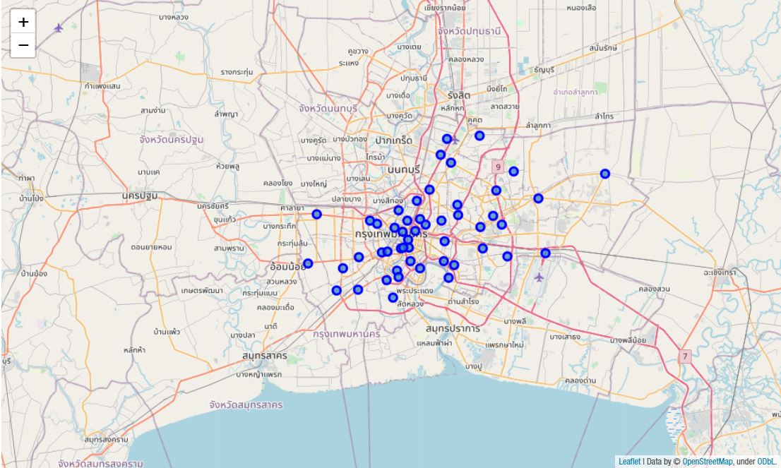
The map of Bangkok districts

Slide 6
Methodology (Continue)
 | District | Coffee shop
0 | Bang Bon | 3
1 | Bang Kapi | 10
2 | Bang Khae | 2
3 | Bang Khen | 4
4 | Bang Kho Laem | 9
5 | Bang Khun Thian | 10
6 | Bang Na | 4
7 | Bang Phlat | 5
8 | Bang Rak | 6
9 | Bang Sue | 3
10 | Bangkok Noi | 4
11 | Bangkok Yai | 3
12 | Bueng Kum | 5
13 | Chatuchak | 13
14 | Chom Thong | 3
15 | Din Daeng | 9
16 | Don Mueang | 10
17 | Dusit | 7
18 | Huai Khwang | 4
19 | Khan Na Yao | 5
20 | Khlong Sam Wa | 3
21 | Khlong San | 4
22 | Khlong Toei | 14
23 | Lak Si | 11
24 | Lat Krabang | 0
25 | Lat Phrao | 10
26 | Min Buri | 3
27 | Nong Chok | 4
28 | Nong Khaem | 1
29 | Pathum Wan | 4
30 | Phasi Charoen | 5
31 | Phaya Thai | 10
32 | Phra Khanong | 9
33 | Phra Nakhon | 3
34 | Pom Prap Sattru Phai | 2
35 | Prawet | 0
36 | Rat Burana | 9
37 | Ratchathewi | 7
38 | Sai Mai | 1
39 | Samphanthawong | 5
40 | Saphan Sung | 8
41 | Sathon | 6
42 | Suan Luang | 8
43 | Taling Chan | 5
44 | Thawi Watthana | 3
45 | Thon Buri | 6
46 | Thung Khru | 5
47 | Wang Thonglang | 9
48 | Watthana | 9
49 | Yan Nawa | 5
 | Sum | 288
Stage 2
Use data from Foursquare API, limited only 200 venues, within radius 1500 m from center of each district
Selected only venues with ‘Coffee shop’ category and show number of coffee shops in each district
There are total 288 coffee shops acquired

Slide 7
Methodology (Continue)
Stage 3
Use data from Foursquare API again, but this time use number of distinct categories in each district, to find the frequency and characteristics of venues in each one.
Number of all venues collected: 3927
Then, in each district, the data will be grouped by venue category. Frequency of venue category in one hot encoding form is used to analyze the characteristics of venues in each district.
Afterwards, Bangkok districts will be clustered by K-mean clustering. Using 6 as number of clusters. Districts that are in a same cluster as Phaya Thai will be assumed to have similar characteristics to Phaya Thai

Slide 8
The district(s) that met all criteria will be selected as a result

Slide 9
Results (1)
 | District | Population18_40
1 | Bang Kapi | 46041
2 | Bang Khae | 62257
3 | Bang Khen | 61167
4 | Bang Khun Thian | 61456
5 | Bang Sue | 38954
6 | Bueng Kum | 44623
7 | Chatuchak | 50305
8 | Chom Thong | 47742
9 | Din Daeng | 36669
10 | Don Mueang | 60739
11 | Khlong Sam Wa | 67490
12 | Lat Krabang | 60729
13 | Lat Phrao | 36377
14 | Min Buri | 45691
15 | Nong Chok | 59228
16 | Nong Khaem | 50783
17 | Phasi Charoen | 40079
18 | Prawet | 59059
19 | Sai Mai | 66690
20 | Suan Luang | 41484
21 | Thung Khru | 39991
Table : Population age 18-40 above average

Slide 10
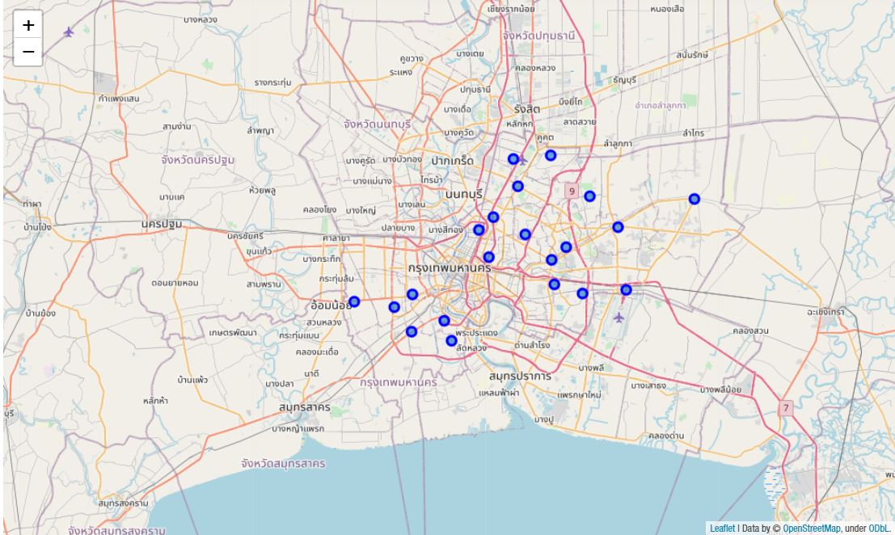
Location of districts which have above average population

Slide 11
Results (2)
 | District | Population18_40 | Coffee shop | Including her | Per Person
1 | Lat Krabang | 60729 | 0 | 1 | 60729
2 | Prawet | 59059 | 0 | 1 | 59059
3 | Sai Mai | 66690 | 1 | 2 | 33345
4 | Nong Khaem | 50783 | 1 | 2 | 25391.5
5 | Bang Khae | 62257 | 2 | 3 | 20752.33
6 | Khlong Sam Wa | 67490 | 3 | 4 | 16872.5
7 | Bang Khen | 61167 | 4 | 5 | 12233.4
8 | Chom Thong | 47742 | 3 | 4 | 11935.5
9 | Nong Chok | 59228 | 4 | 5 | 11845.6
10 | Min Buri | 45691 | 3 | 4 | 11422.75
Table : Top 10 Population age 18-40 per coffee shop including her one

Slide 12
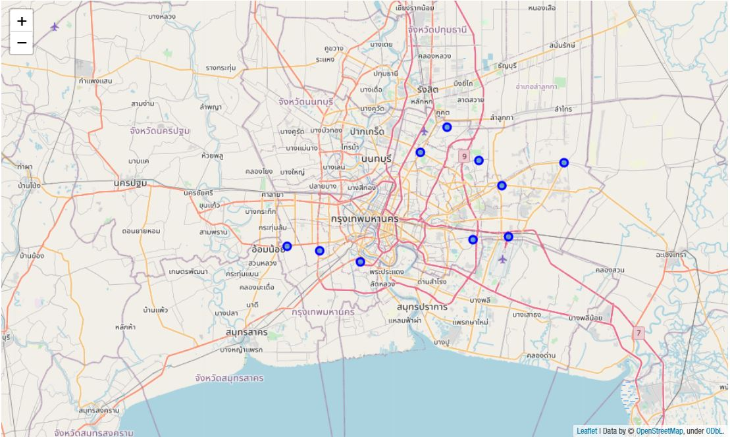
Location of district with top 10 Population age 18-40 per coffee shop including her one

Slide 13
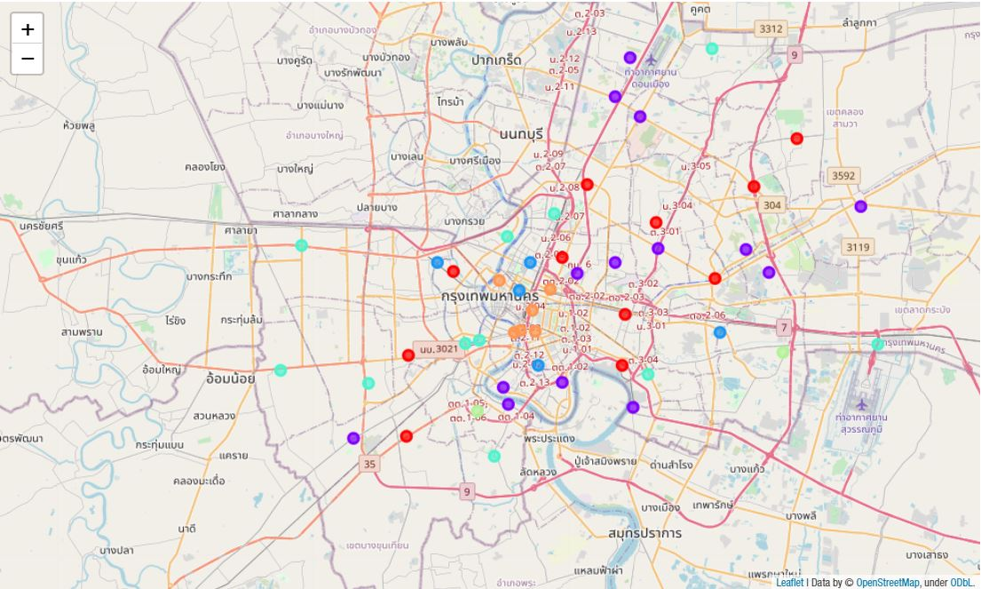
3) The map shows result after clustering Bangkok districts into 6 clusters

Slide 14
Result (3)
Phaya Thai is in cluster label 1.
The districts in cluster label 1 are Bang Kapi, Bangkok Noi, Chatuchak, Khan Na Yao, Khlong Sam Wa, Khlong Toei, Lat Phrao, Phasi Charoen, Phaya Thai, and Watthana

Slide 15
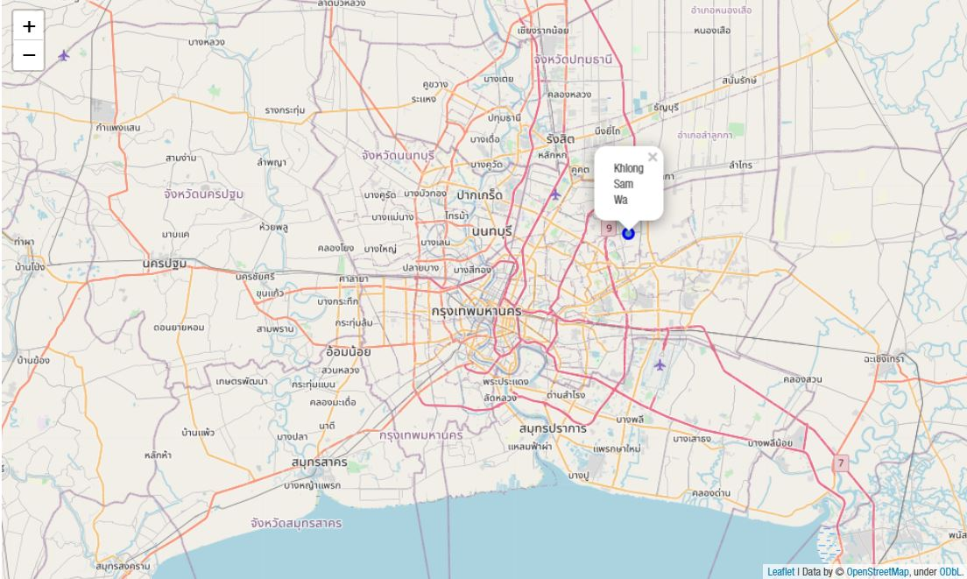
The district that met all criteria is ‘Khlong Sam Wa’

Slide 16
Discussion
From the results, the following recommendations can be made:
There is only 1 district that fits all criteria, that is ‘Khlong Sam Wa’, Hence, it is the recommended location for this client
Other choices to consider are Lat Krabang and Prawet since these 2 have no already existing coffee shop in this data frame
From the observation, the districts with more population and less already existed coffee shops are mostly situated at outskirts of Bangkok

Slide 17
Discussion
There are some points to concern of when using this data and study
The data from foursquareAPI is limited to only 200 venues per district and only within a radius of 1500 metres.
There is no data on coffee carts which are common in bangkok.
Seeing that there are many types of coffee shops and a wide range of prices per 1 cup, the next evaluation should include the price of location, GDP, and more information of each district.
This study was created during the COVID-19 crisis and it affects economics around the world including Bangkok, leading to a change in the number of shops and venues in Bangkok. Thus, the study should be performed again after this situation subsides.

Slide 18
Conclusion
The best location for this client’s next coffee shop branch is ‘Khlong Sam Wa’ based on population, coffee shops and other venues of each district. Next appropriate choices are Lat Krabang and Prawet.
This study is limited due to some reasons and it should be performed again to follow the trend of economics around the world.

